Slide 1


Gamification
Lecture 12

Slide 2
What is Gamification?
Gamification is the use of game elements and game design techniques in non-game contexts.
It is an instructional strategy to increase engagement, learning, motivation, and participation.
Gamification principles include challenges, rewards, competitions, personalization, and levels, which prompt people to get engaged and always come back for more

Slide 3
Game Elements
Achievements
Avatars
Badges
Challenges
Countdown
Leaderboards
Points of Levels
Progress Bars
Social Interactions and Sharing
Quizzers
Virtual Coins

Slide 4
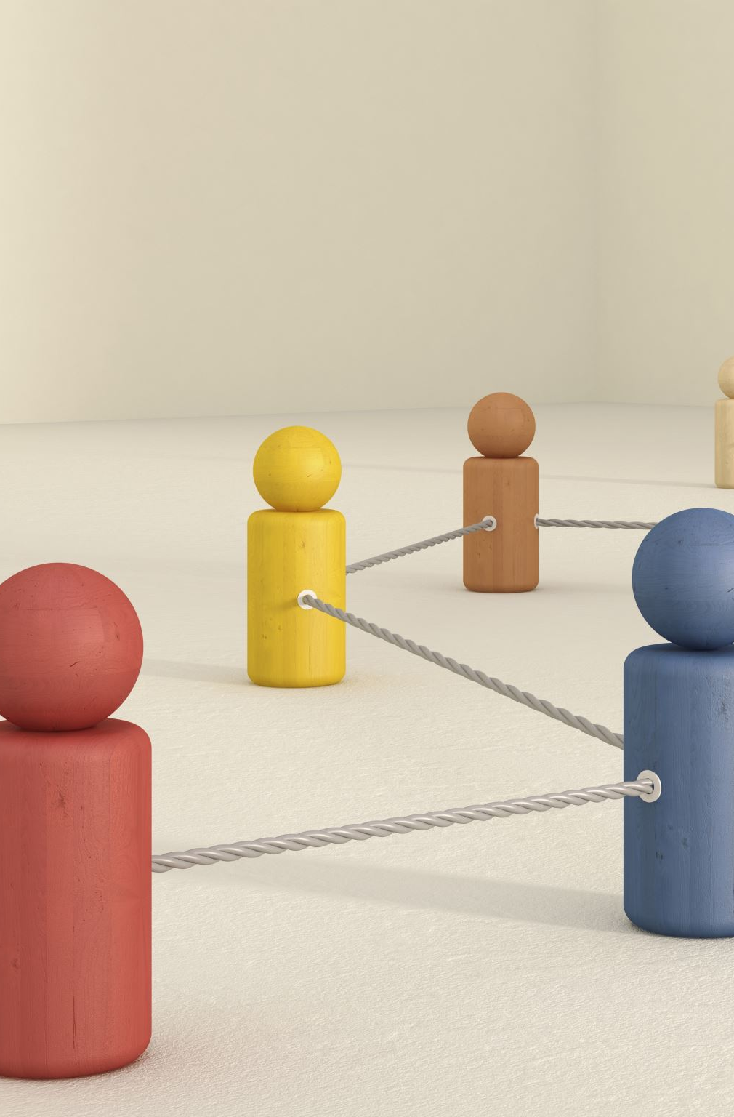
Game Elements (Cont’d)
Gamification serves user engagement, cooperation, and collaboration.
Gamification is implementing game mechanics in non-game contexts to make it more engaging and fun.
Some applications include gamification of the sales and marketing process targeted toward customers and suppliers and gamifying the HR process to engage and motivate employees and encourage positive behavior and habits.

Slide 5
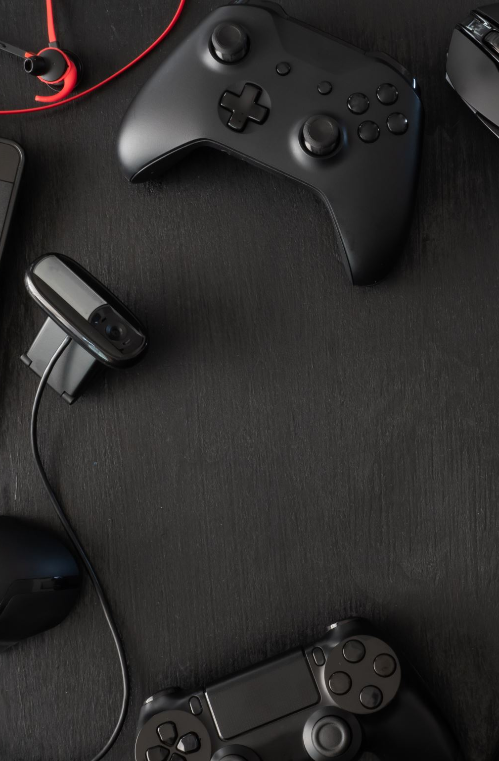
Gamification in Business
Today, Gamification has become tremendously popular among non-gaming environments.
Gamification transforming the business domain:
The global gamification market size is projected to grow from $9.1 billion in 2020 to $30.7 billion by 2025.
95% of employees enjoy using gaming-inspired elements in their work.
Gamification participants score 14% higher on skill-based assessments.
72% of employees claim gamification inspires them to work harder.
Using gamified activities increases motivation by 48%

Slide 6
Characteristics of Gamification
Bridges the engagement gap by making the product more engaging and game-like to use the product.
Instills positive behaviors and builds habits in target users.
Motivates users to perform predefined tasks to improve business growth.
Allows users to share information about the competition, points, and status with other users.
Improves retention by rewarding users with badges and points for their efforts.

Slide 7
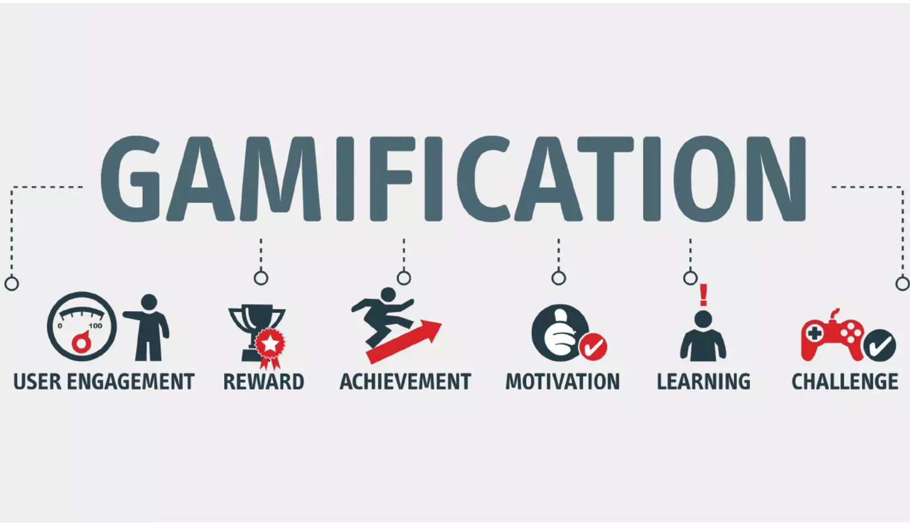
Gamification Use Cases

Slide 8
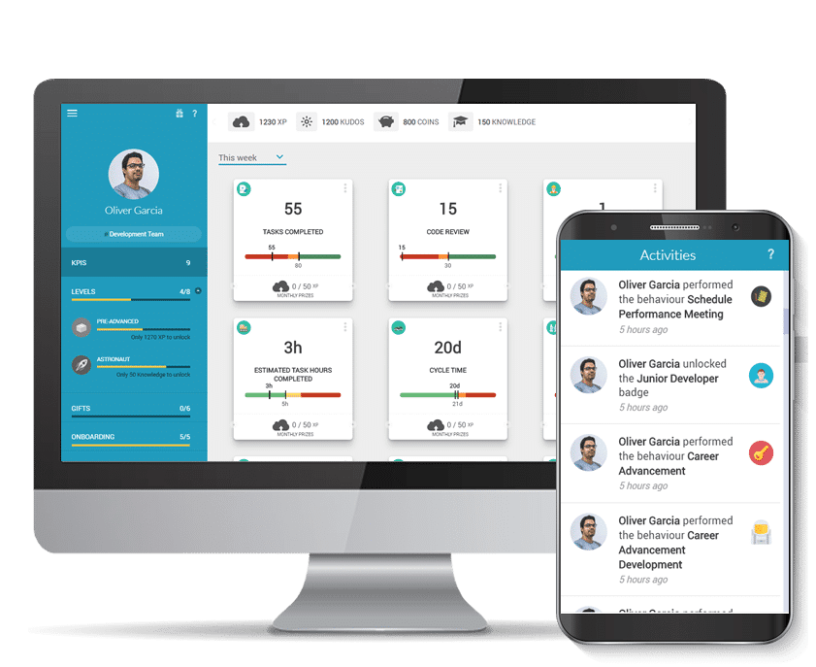
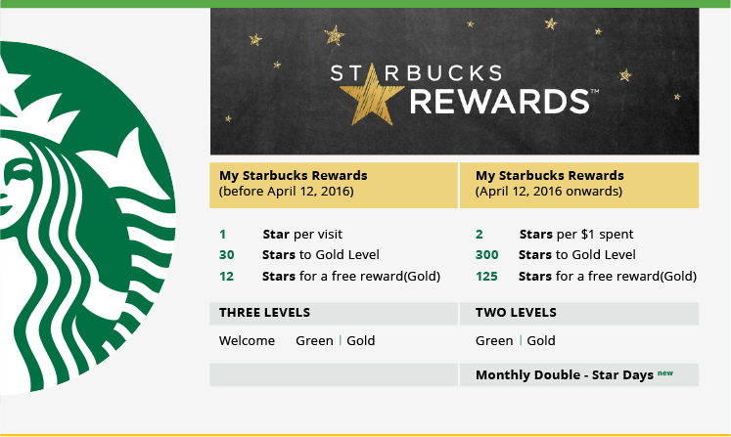
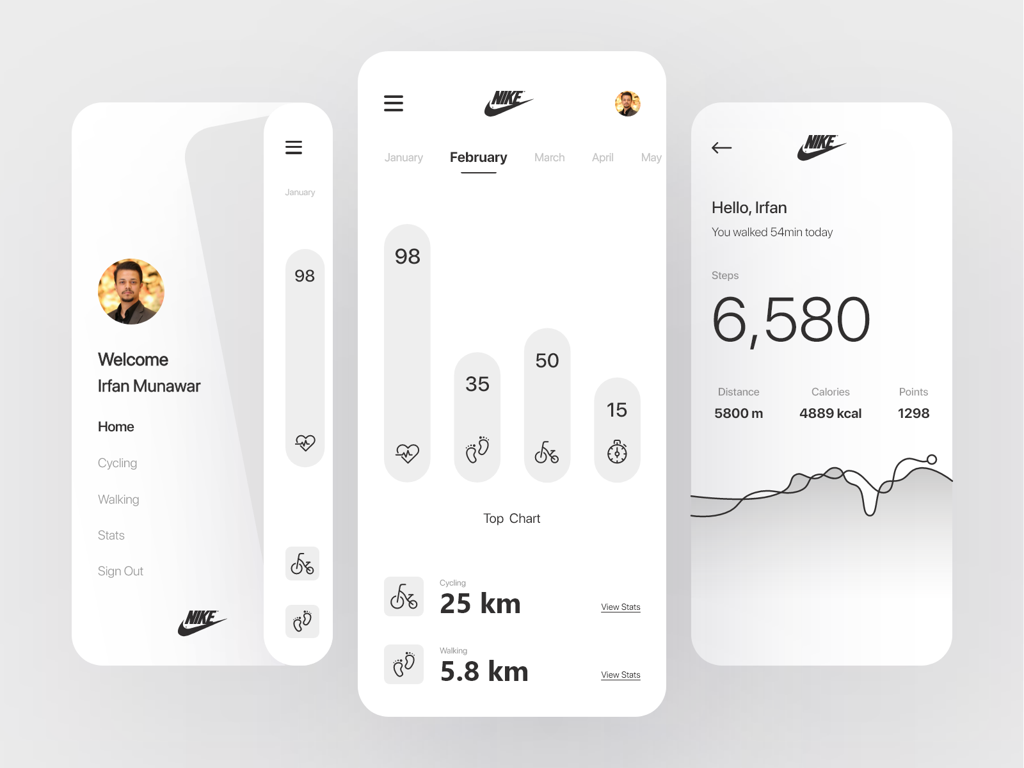
Gamification Use Cases (Cont’d)
Starbucks
They launched ‘My Starbucks Rewards’- a loyalty program where customers earn points whenever they make purchases.
Nike
Nike fitness app- NikeFuel leveraged social sharing to engage over 5,000,0000 users to beat their personal fitness goals every day.
Deloitte
Deloitte is one of the world’s largest consulting firms that leveraged game mechanics for their training application.

Slide 9
The Psychology behind Gamification
As gamification triggers real, powerful human emotions, our brain’s structure is linked with pleasure, and learning releases and re-absorbs the neuro-transmitted dopamine in response to activities such as winning, recognition, problem-solving, surprises…etc.
This dopamine rush maximizes user engagement, retention, and business growth.
Gamification reinforces habits by rewarding users at each stage of the journey.
When a user completes an action, they get rewards, badges, or points.
Achievement is one of the most potent psychological drivers of human behavior.
If you can make users feel they have achieved something, they are going to come back, thus improving user engagement.
Notes:
Psychology tells us that people don’t like to be forced or dragged to do said activities. They like to feel in control.
Gamification gives users control. It allows them to pick levels at which they want to experience the product, leading potential customers toward the desired goal.

Slide 10
The Psychology behind Gamification (Cont’d)
While gamification is a way forward to improve user engagement and retention, here are some things you need to know before leveraging it:
Gamification is NOT a game: gamification is not just a video game; instead, it uses game mechanics to induce certain habits and behaviors. Gamification harnesses the tendency to influence one’s behavior and thinking.
Gaming versus traditional learning: Game-based learning is unique in its way. It involved a higher level of customization, and participants can learn at their own pace. At the same time, traditional learning is monotonous and often difficult to comprehend by each learner.
Driving intrinsic motivation: When it comes to motivation, employees are more motivated by job satisfaction than case rewards. Intrinsic motivation matters more than extrinsic motivation. It is essential to design an effective gamified solution to ensure that gamification activities meet organizational goals.

Slide 11
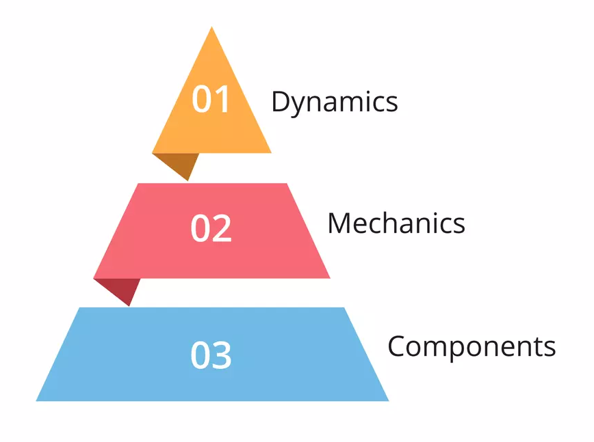
An Effective Gamified Product
Designing an effective gamified product requires thinking like a game designer.
Understand the user journey and get the user onboard as quickly as possible. Simple onboarding without complexity always works best.
It should have a sense of competition, fun, and balanced use of game elements to engage users and create an interactive experience.
The perfect gamified product should follow the “Pyramid of Elements” which should include: dynamics mechanics, and components.
Additionally, it emphasizes design detail while deploying gamification.

Slide 12
Pyramid of Elements
Dynamics: is the top of the pyramid that is being designed. It includes constraints, emotions, narrative, progression, and relationships. These dynamics are essential when designing because they give a purpose to the user’s actions dynamics help motivate users to achieve a particular goal.
Mechanics: explains how users will accomplish tasks. It contains challenges, chance, competition, cooperation, feedback, rewards, win status, and transactions.
Components: it encompasses achievements, badges, leaderboards, points, levels, and quests. A gamified product must contain these elements, and there should be coherence between them to become a successful gamified product.

Slide 13
The PBL System
Points, Badges, and Leaderboards (PBL) are some of the most influential and widely used game elements for your product’s gamification.
Points enable users to keep score, determine win status, display progress, and connect to rewards.
Badges represent achievements, and flexibility, and signal social status.
Leaderboards rank users based on their actions in the product.
Although the PBL elements are more prominent, they are not all-inclusive. There are other play elements such as opinion polls, puzzles, trivia, streaks, etc., to motivate users and make your app and website more engaging and fun.

Slide 14
Major Gamification Trends
Artificial Intelligenece (AI)
AI has become all-encompassing among businesses, as it brings together brief analysis from large data sets. AI-run solutions are more common and less expensive than ever before. The same data analysis would cost employees many thousands of dollars and hours; companies can access it efficiently.
Mobile and Social Sharing
The ubiquity of mobile usage for both work and play has driven the rise of gamified mobile applications. Employees can get notifications on the phone about the sales numbers, and work orders, and consumers can interact with apps from anywhere.
Instagram, Facebook, Twitter, Snapchat, etc. The reinforcement of gamified elements in social media interactions supports bsuiness goals.

Slide 15
Major Gamification Trends (Cont’d)
Gamified Learning
Gamification of learning is an educational approach to motivating students by using game elements and game design techniques in a learning environment.
The goal is to maximize learning while maximizing enjoyment and engagement.
Progress mechanics: points, badges, leaderboards, facilitate learning.
Leveraging gamified learning increases fun and joy in the classroom.
When done right, game-based learning can take training and learning to the next level, from gaining basic knowledge to the application of critical thinking and more accurate decision-making.

Slide 16
Application of Gamification in the Business World
Leveraging game elements for business solutions encourages employees to contribute, enhance the quality of participation, boost productivity, and develop leaderboards to rank people based on their involvement and expertise.
Productivity Enhancement: Gamification motivates employees and provides valuable feedback to improve their performance. Gamified solutions can highlight the KPIs, achievements, and numbers in a positive way to encourage employees to do productive work.
Efficiency Enhancement: Grammarly is one of the best examples of leveraging gamification to encourage users to write more efficiently. Gamification makes employees work better by improving their core jobs.

Slide 17
Application of Gamification in the Business World (Cont’d)
Human Resources: HR takes responsibility for hiring, critical onboarding, training, and ongoing performance management initiatives.
Recruitment: introducing gamified elements can identify the best candidate and review candidates in the recruitment process.
Onboarding: leveraging points and progress bars to onboard employees quickly and hassle-free.
Training: use of game mechanics to encourage employees and reward them for learning and attending training sessions.

Slide 18
Application of Gamification in the Business World (Cont’d)
Performance Review and Employee Recognition: recognizing employee’s efforts by awarding badges, points, and other forms of recognition instills a sense of achievement and motivate them to work better.
Innovation and Skill Development: employing game mechanics can encourage employees to develop remarkable new ideas. Learning involves problem-solving and engaging those parts of the brain that love to figure out new things, leading to skill development.
Sales: sales often run on a natural sense of competition for its best deals and strategies. Gamification can help them focus on crucial enablement tasks, promoting overall revenue generation.
Marketing and Customer Engagement: gamification can help marketers increase customer lifetime value, retention, and engagement across the customer lifecycle.

Slide 19
Thank You ☺
Any Questions?!

